Slide 1
Nomis Time Save Exercise and Avoiding Lost Productivity
By John Saunders

Slide 2

Background
Nomis is the most used tool in the prison service and in my opinion is inefficient in certain areas and has a poor user interface. It takes too much time and too many clicks of the mouse to access the relevant data that the majority of people want to access.
To this end I have conducted an experiment to find out how much time is being wasted on a daily, weekly, monthly and yearly basis.
I believe that there is a huge loss in productivity in this area of our work and it could potentially save time and money by making minor alterations to the user interface and the options presented to the end user at certain stages of the use cycle.

Slide 3

The Experiment
Based on 2 seconds per click to get from log in to prisoner data there are as a minimum 5 clicks then potentially more to get to the most accessed data. That data being financials, positive / negative entries, CSRA level or IEP level.
For the benefit of this experiment I will use the base of 2 second per click and 5 clicks to access the data. (total 10 Seconds)
Then I am basing the next data set on an average day and the repeated process on different wings. Lets say 18 users, in a prison on an average day this is much higher but for the sake of this exercise I’m going to use this figure.
Users an overage repeat the same process 10 times a day.
10 uses x 8 seconds extra compared to the proposed changed = 80 seconds

Slide 4

The Math
80 seconds x 18 users = 1440 seconds / 60 min = 24 min per day / 2.8 hours a week / 11.2 hours a month / 134.4 hours or 5.6 days a year wasted productivity that could be avoided.
These figures are based on a person who is computer literate and familiar with the system, executing commands at 2 seconds per click.
Potentially the click time could be as much as 6 seconds for someone who is less computer literate or not familiar with the system in which case the time save could be dramatically different (16.8 days per year).

Slide 5

Research Conducted
Identify the Biggest Waste to Increase Productivity
The biggest waste in most companies, whether service, distribution or manufacturing, is wasted chronological time. In the 4-part series “The Fabric of the Cosmos”, physicist Brian Greene explains the science behind Einstein’s theory of relativity, which makes time travel possible. While physicists debate the theoretical fine points, time marches forward in an unstoppable fashion for the rest of us. Each second ticking by, gone forever, never to be recaptured. Time only moves forward, never backward. When we allow the minutes to pass by without productive effort, we lose them forever.
The prison service have not addressed this and are allowing those seconds, minutes and hours to tick by without concern for productivity. The biggest waste is a constant struggle, A second may not seem like a significant time loss but imagine if every mouse click took two seconds instead of one second. The slow response means we can only do half as many mouse clicks in a day, which literally means we can only do half as much work in a day. In many companies, worker productivity is only one half or even one third of what it actually could be and should be.
From another perspective, imagine if the Prison service could be twice as productive with the same number of employees and the same amount workers and the same capital investment in equipment. When we start thinking in these terms, the true implications of wasted time become quite clear and begin open our eyes to all kinds of possibilities.

Slide 6

Suggested Changes
When a user first logs into Nomis 99% of users want to find a prisoner but the first screen you see is blank. Then you have to go to name search and select your prisoner and nothing happens. Then you have to go to case notes to get a basic set of information which has little structure other than a chronological list of occurrences which is fine if you don’t want to find anything specific but usually the user is looking for one or more of the following:
CSRA level and specific details
Positive entries
Negative entries
Financials
Release date
Adjudications
Alerts
IEP Level
Name, Number and Location
Smoking status
Visits booked and allowance
Ethnic Code
Picture of the prisoner

Slide 7


The Old Process
Initial Screen

Slide 8
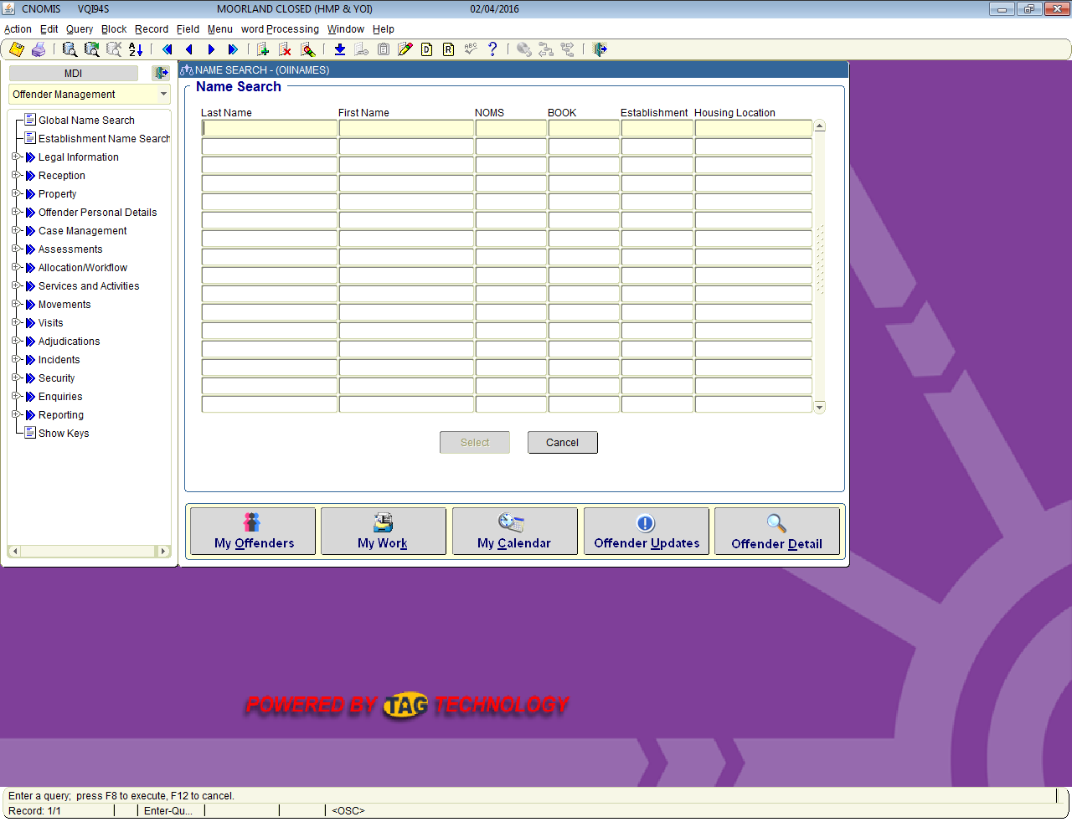
The Old Process
Then Search and click perform task

Slide 9
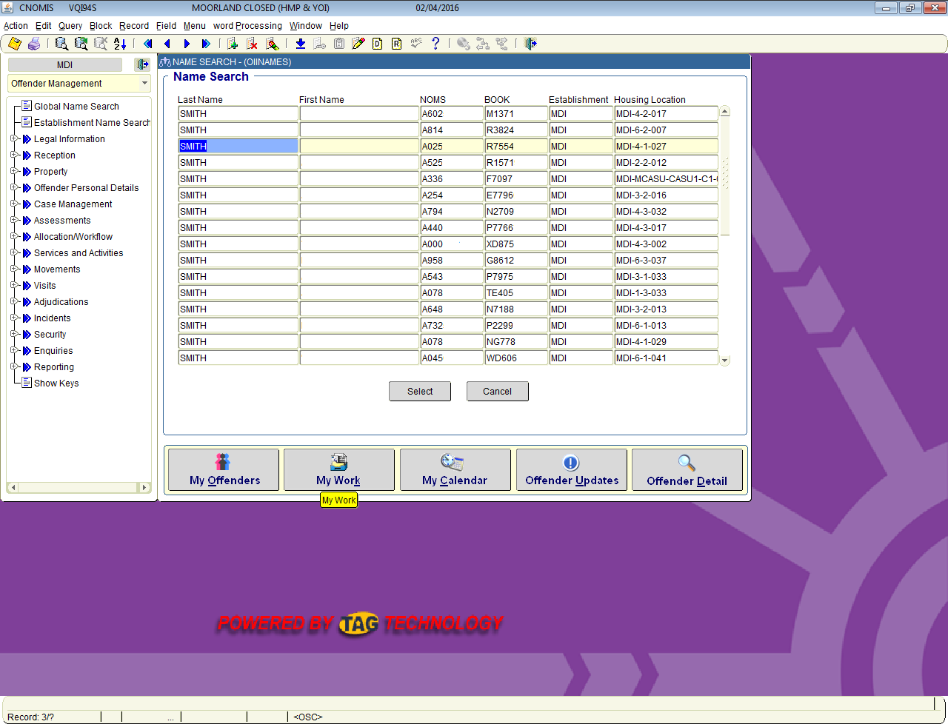
The Old Process
Click Select prisoner

Slide 10

The Old Process
Once selected you are presented with a random blank page with no information

Slide 11

The Old Process
Now navigate to case notes and click to expand and click again to access case notes

Slide 12
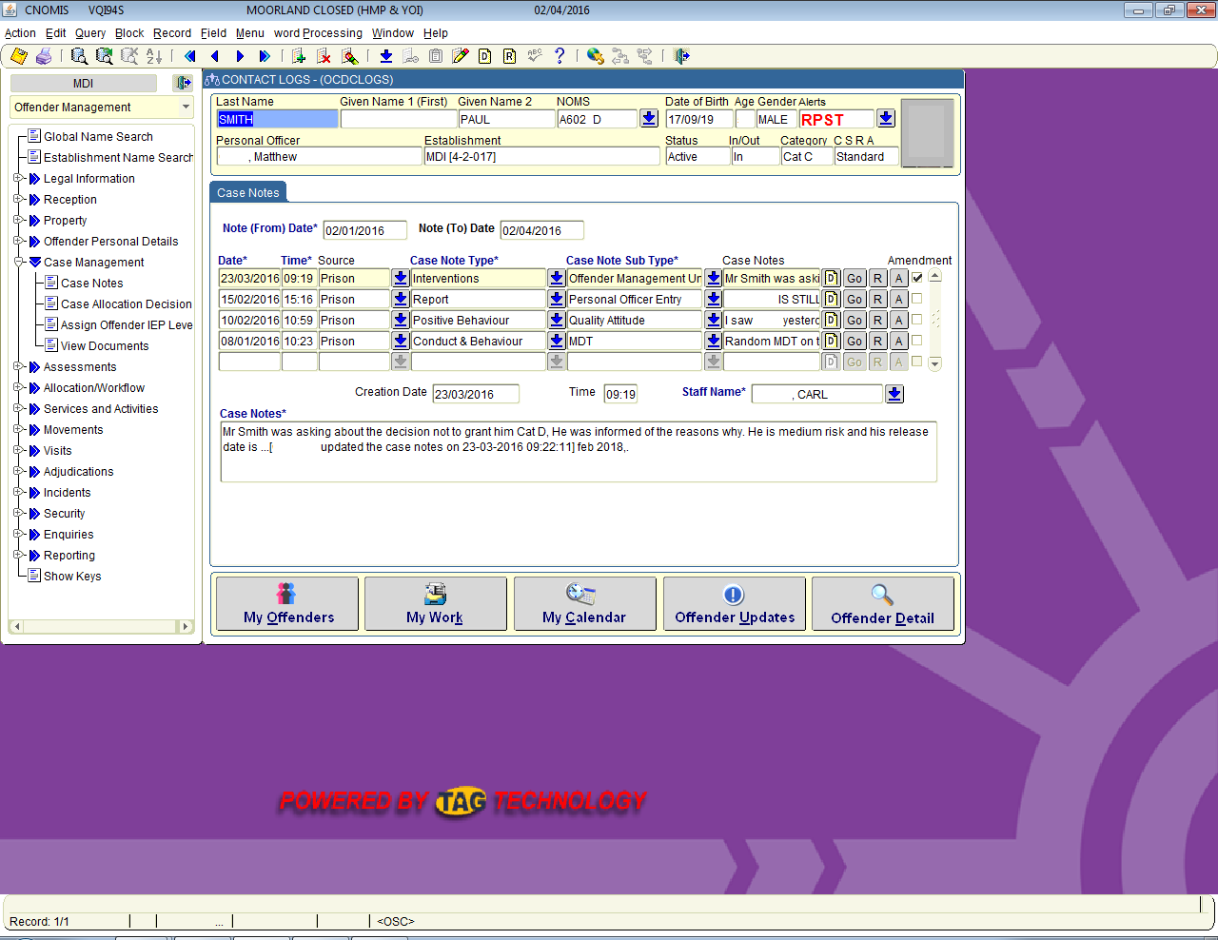
The Old Process
You are now presented with limited information in chronological order and some personal data with no description as to what it is without navigating further.

Slide 13
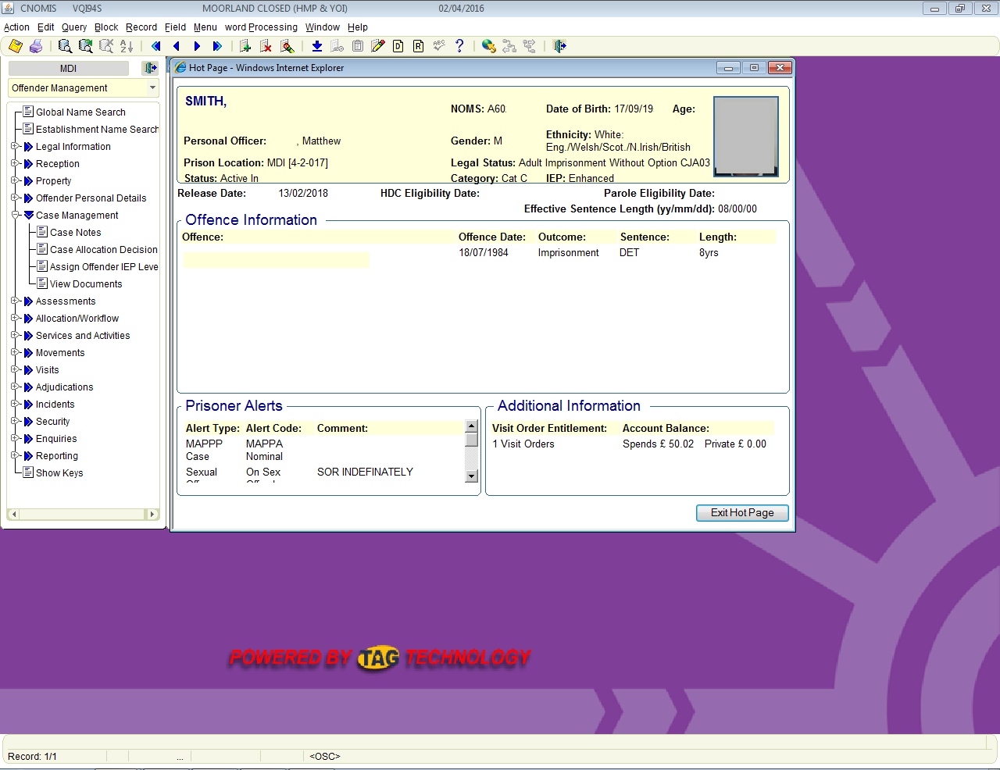
The Old Process
Now click hot page to get some more limited information

Slide 14
The Old Process
This process is long drawn out and inaccurate as not all of the data sets are descriptive enough. To find information on for example negative entries there are many more clicks involved and to find out CSRA details you have to navigate to an entirely different screen.
The following slides detail the proposed changes and alterations to the hot page to make it usable in day to day situations for Prison staff in all departments, not just on the wing.

Slide 15

The New Process
The first screen the majority of people need is the search screen so on log in display this first rather than a blank page.

Slide 16
The New Process
Search results will be displayed in the same fashion.

Slide 17
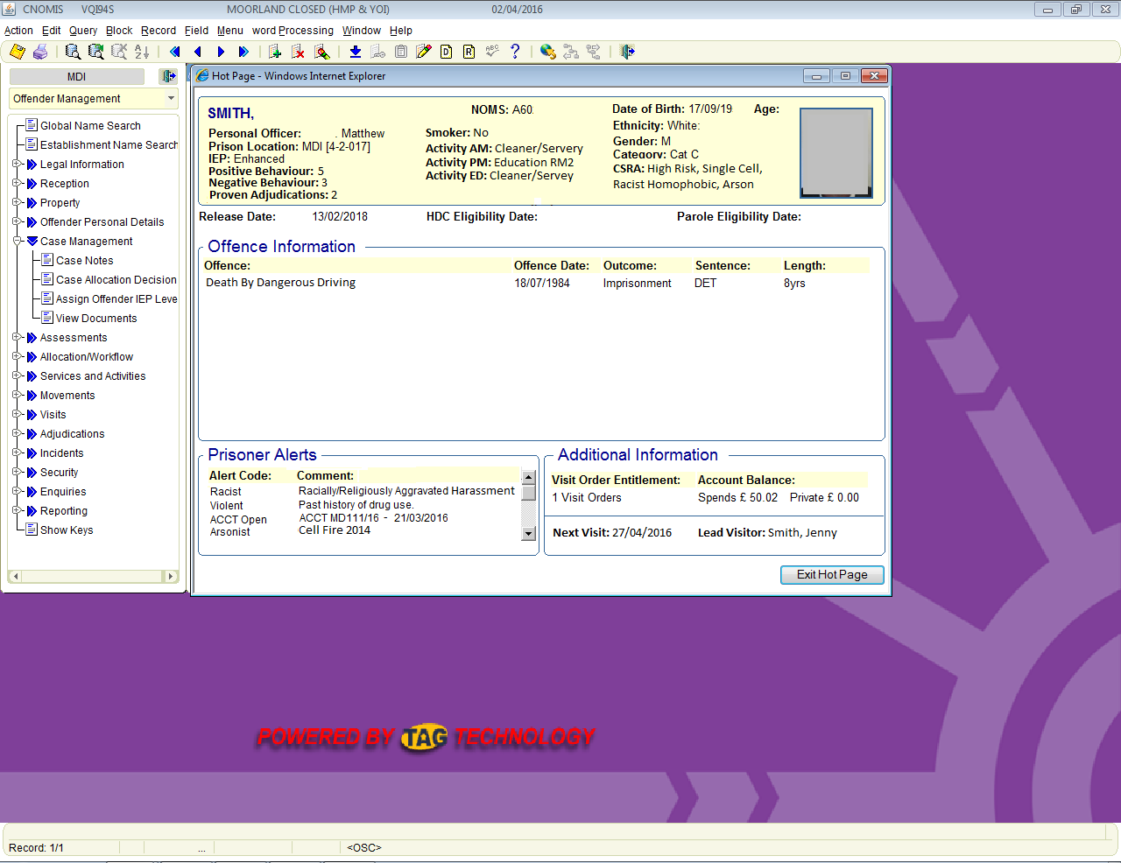
The New Process
Upon clicking the select button the next page to be displayed automatically would be a redesigned Hot Page which could potentially look like this.

Slide 18
The New Hot Page
As you can see all relevant information is listed without having to navigate to any other page.
Alterations have been made to the alerts section listing the type of alert and the first 4 words of the description to give a brief overview of the alerts. If any more information should be required it could be sourced from the main alerts section however in most circumstances this information should be sufficient.
The visits section now includes the next booked visit date and the lead visitor.
The main information panel for the prisoner now includes CSRA level and description, the number of positive and negative entries in the last 3 months, the number of proved adjudications in the last 3 months, AM, PM and ED activity slots, Smoking status and all the previous hot page information from the old format.
This would allow a member of staff to get all relevant information to the majority of enquiries instantly without having to hunt around numerous pages to acquire it. It would also assist in CSRA reviews, IEP reviews and finance enquiries letting the user see the information required at a quick glance rather than having to scroll down a chronological list of irrelevant information.

Slide 19
The New Hot Page
As you can see all relevant information is listed without having to navigate to any other page.
Alterations have been made to the alerts section listing the type of alert and the first 4 words of the description to give a brief overview of the alerts. If any more information should be required it could be sourced from the main alerts section however in most circumstances this information should be sufficient.
The visits section now includes the next booked visit date and the lead visitor.
The main information panel for the prisoner now includes CSRA level and description, the number of positive and negative entries in the last 3 months, the number of proved adjudications in the last 3 months, AM, PM and ED activity slots, Smoking status and all the previous hot page information from the old format.
This would allow a member of staff to get all relevant information to the majority of enquiries instantly without having to hunt around numerous pages to acquire it. It would also assist in CSRA reviews, IEP reviews and finance enquiries letting the user see the information required at a quick glance rather than having to scroll down a chronological list of irrelevant information.

Slide 21

Conclusion
Using the Nomis system as it stands now is ok but wastes time repeatedly, in this one example alone based on login to first task a minimum of 5.6 days a year are wasted for every 18 users in the prison service.
Multiply this figure by the number of active users every day (figures I do not have access to) and I suspect that the wasted days per year would be significant.
Imagine being able to say to someone “we have saved the company 500 days of lost productivity and its not cost a penny, we have used the programmes and systems we already have but given you back 500 days of productive work that can be utilised”.
Thank you for taking your time to digest this presentation.

